Slide 1
EXPLORING THE BENEFITS OF INTERNATIONAL PRACTICE-BASED EDUCATION EXPERIENCES IN SOCIAL WORK AND HUMAN SERVICES’ EDUCATION
by Dr. Nonie Harris; Dr. Deb Miles; Dr. Nigel Chang; Mr. Peter Jones; Dr. Abraham Francis and Ms. Ines Zuchowski.
Department of Social Work and Human Services and the Department of Anthropology, Archaeology and Sociology, James Cook University, Australia

Slide 2


The Aims of our Paper
To describe an innovative, practice-based education (PBE) model that exemplifies the benefits of international, cross-disciplinary collaboration and the creative use of established relationships with Universities outside of the country of origin, in this case Australia. Specifically, the project aimed to further develop an existing relationship with a University in Thailand (NRRU) in a reciprocal manner.
Report on research that aimed to assess, from the perspective of Australian Social Work and Human Services students, the experience of participating in community development programs in Thailand as part of the practice-based education program.

Slide 3
The Goals of the PBE Project
This project aims to further develop a relationship with a University in Thailand (an MOU with NRRU is currently in place), in a reciprocal manner, to provide practice-based education opportunities for students studying Social Work and Human Services at James Cook University; through engagement in international community development experiences in Thailand and, importantly, provide opportunities for Thai students to travel to Australia for similar experiences.
Participation in these international experiences aims to enhance students’ awareness of, and facilitate direct participation in, programs focused on human rights, social capital development and sustainability.

Slide 4
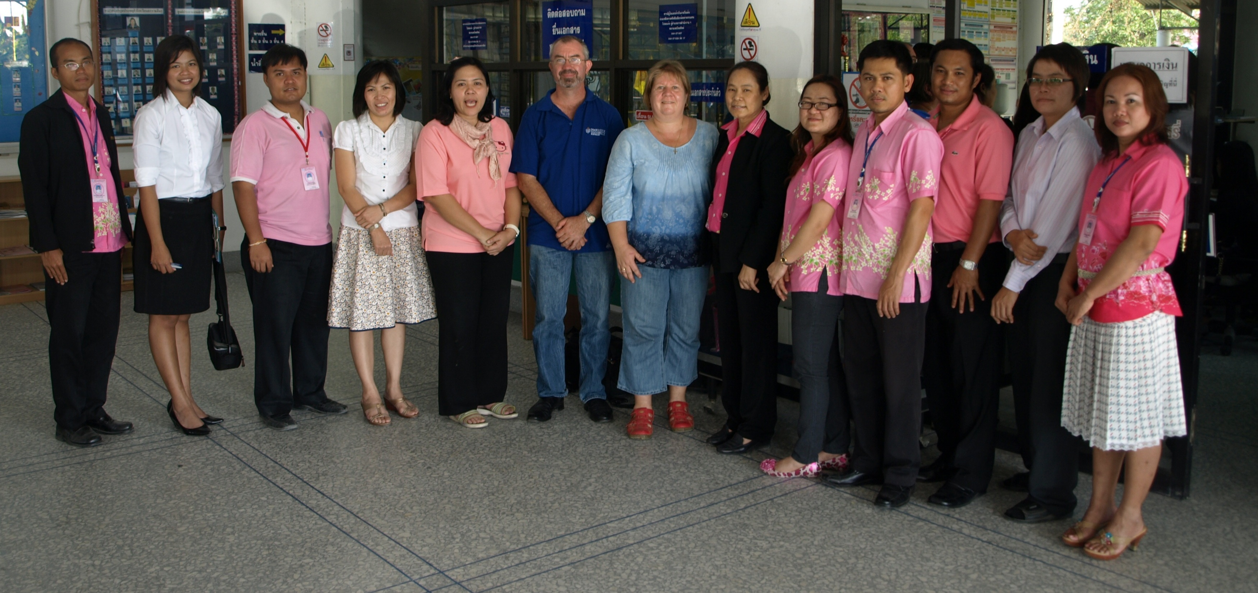
The Project Objectives
To develop a student international experience and exchange program through already established partnerships in Thailand. To meet this objective Australian students will travel to small Thai communities identified by, and under the supervision of, local academic staff from NRRU to participate in community development/ human rights/ social capital development projects of importance and relevance to the local community. And Thai students will travel to Australia to participate in programs relevant to their degrees, under the supervision of JCU academic staff.
To explore and establish opportunities for the embedding of international practice-based learning opportunities into the Social Work and Human Services curricula, and to ensure the integration of these opportunities as core aspects of the curriculum that will endure over time.

Slide 5
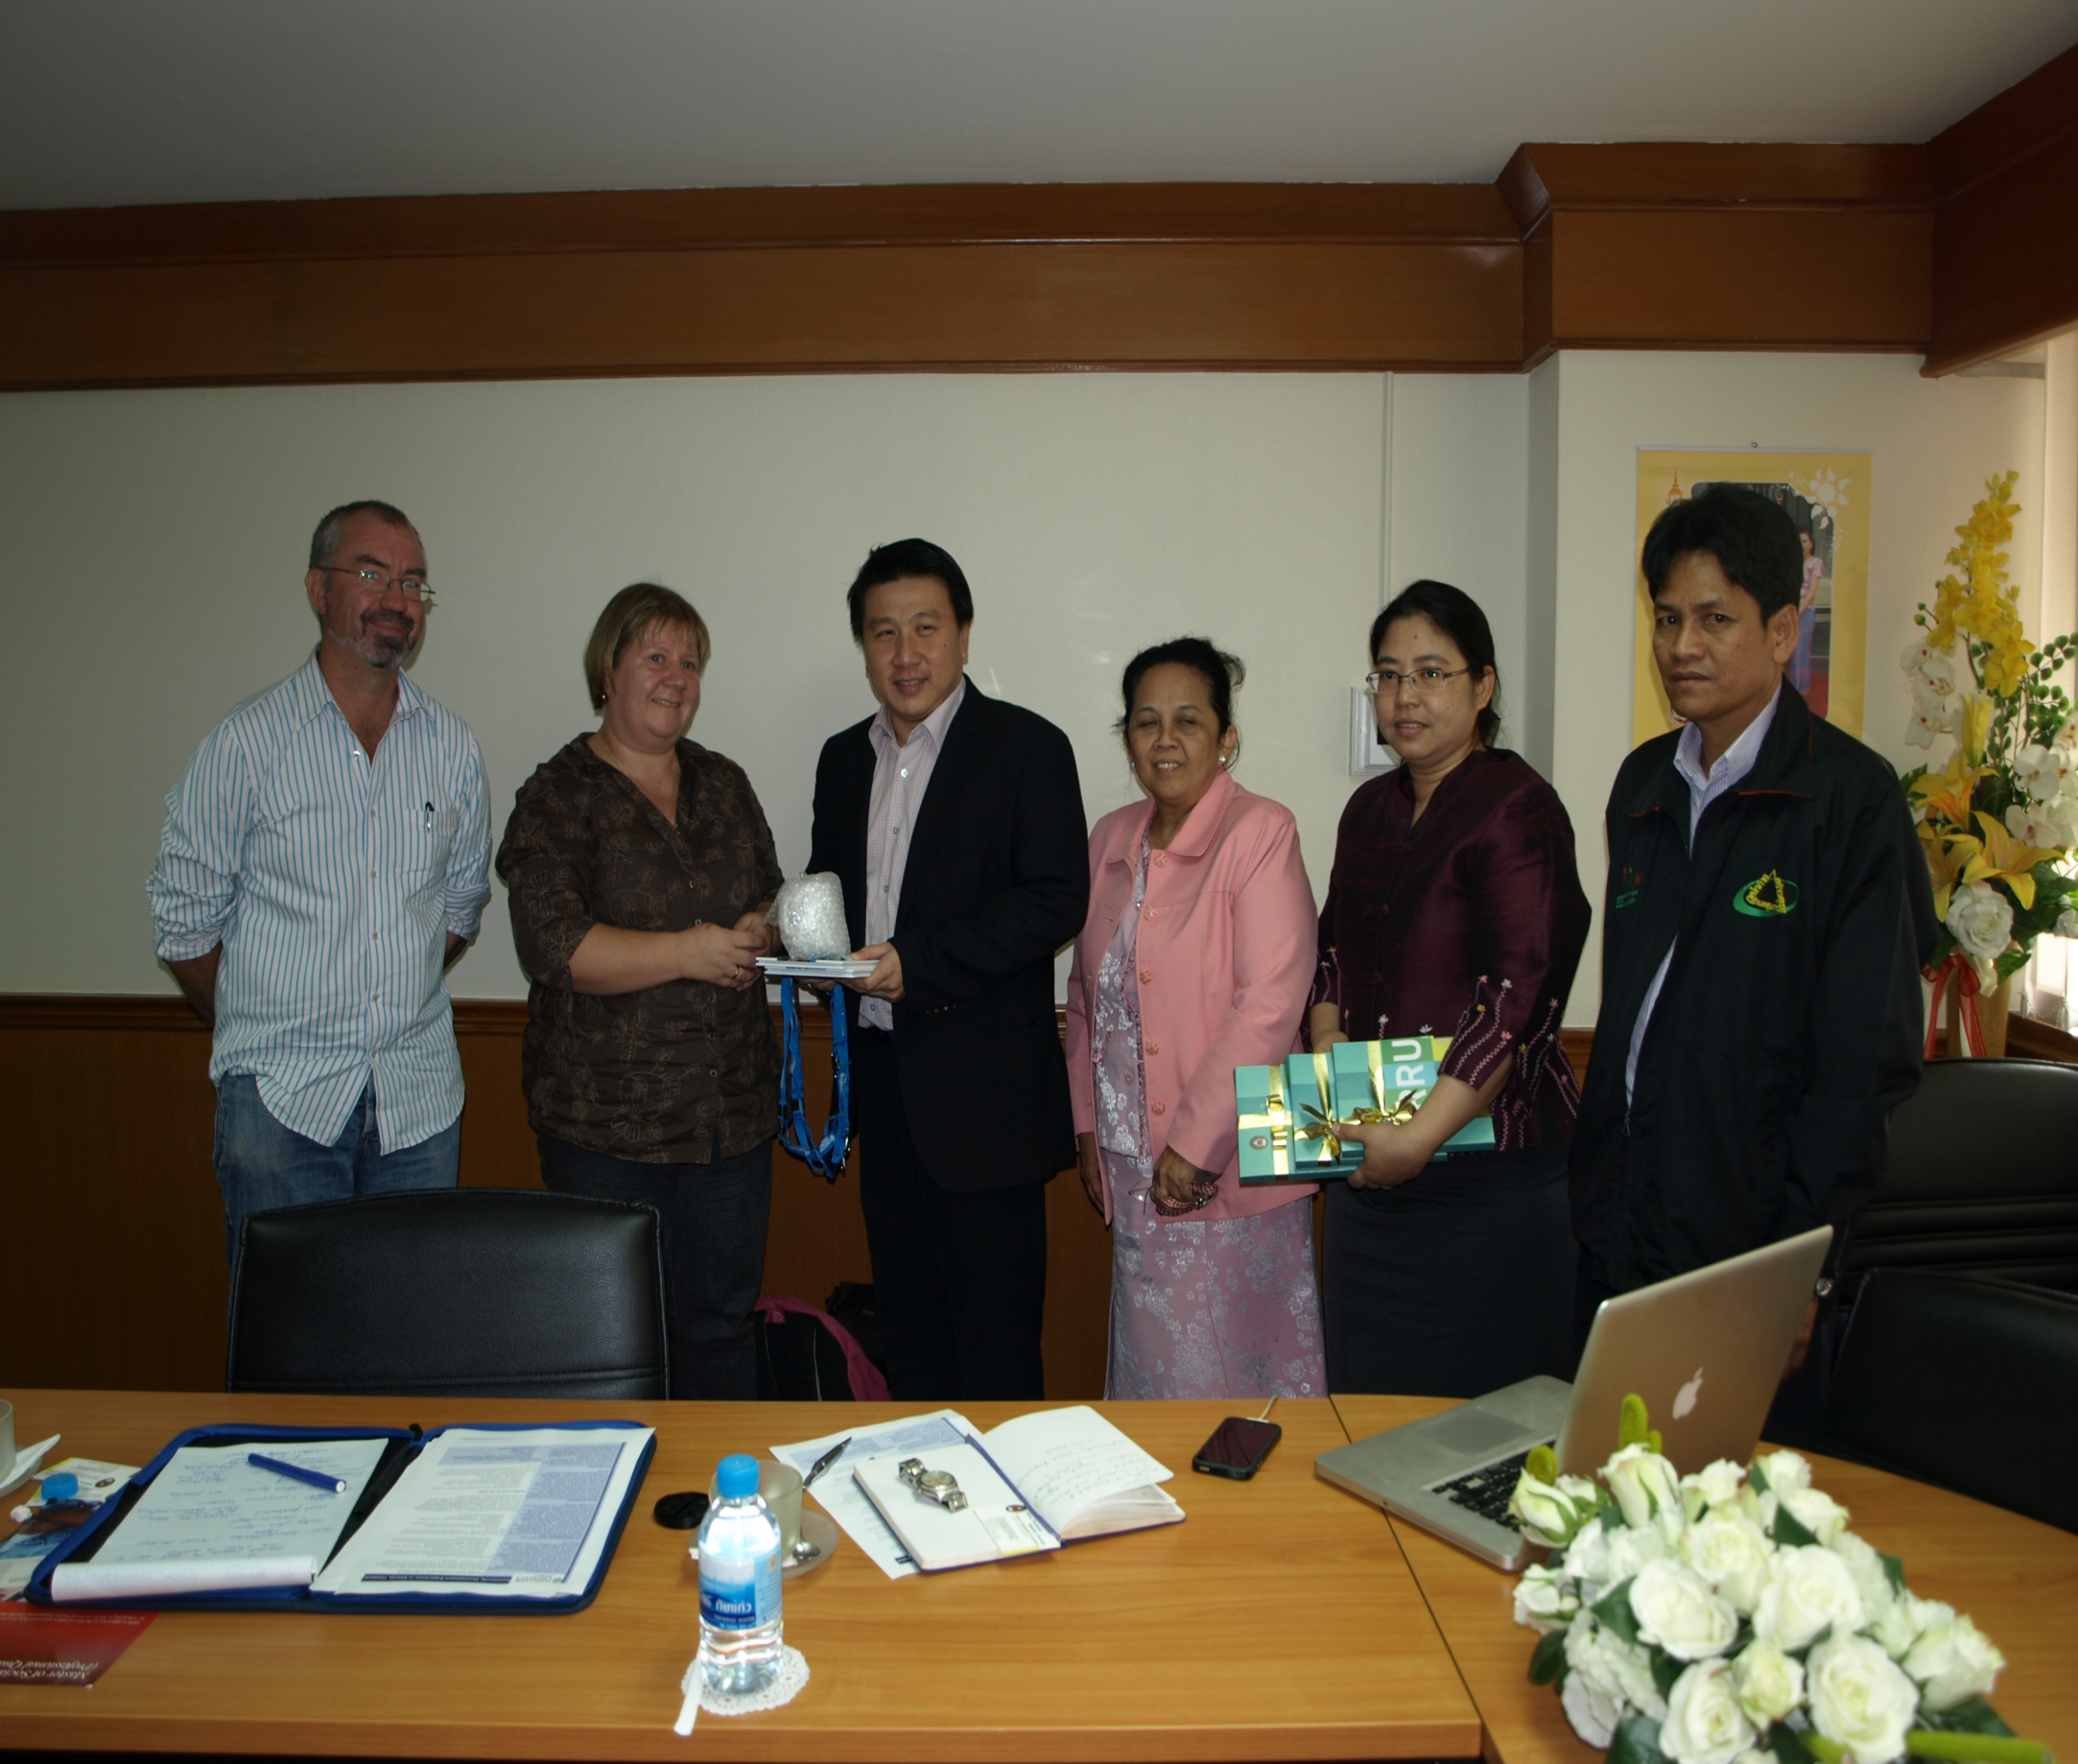
What has the Project Involved
2011
  Building on an existing MOU
  Staff travelling to Thailand
  Recruiting first group of students
  First group of Australian Social Work students travel to Thailand
  Report on integrating the PBE experiences into the curriculum completed

Slide 6
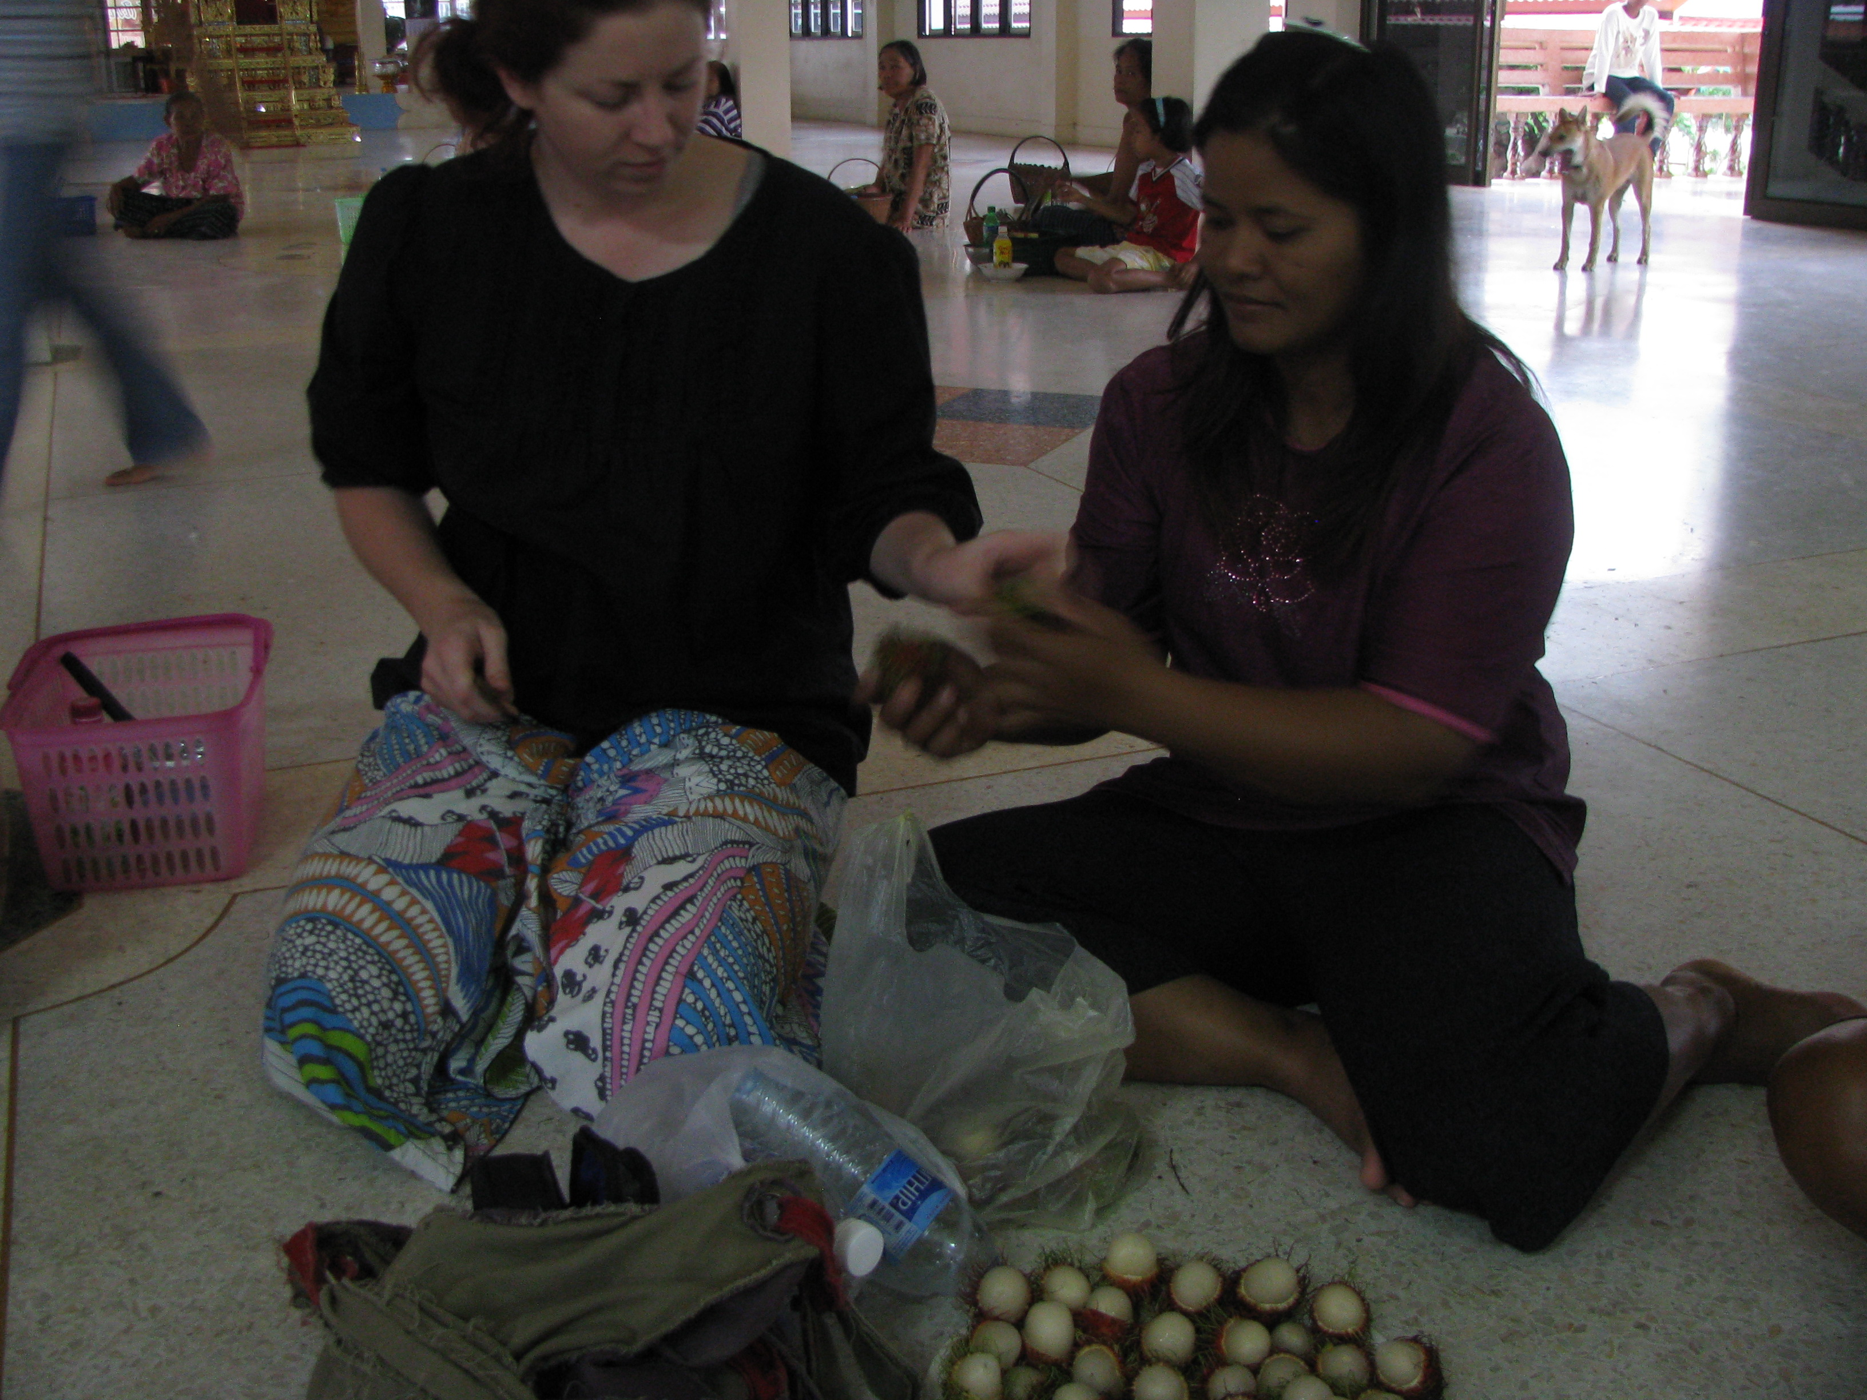
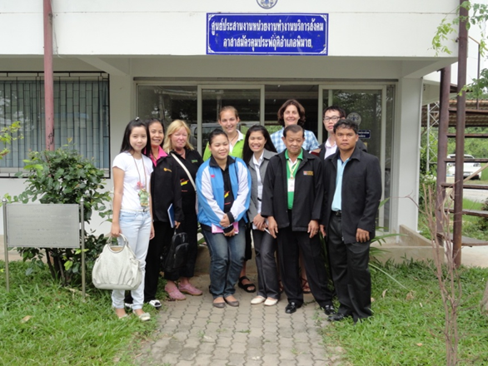
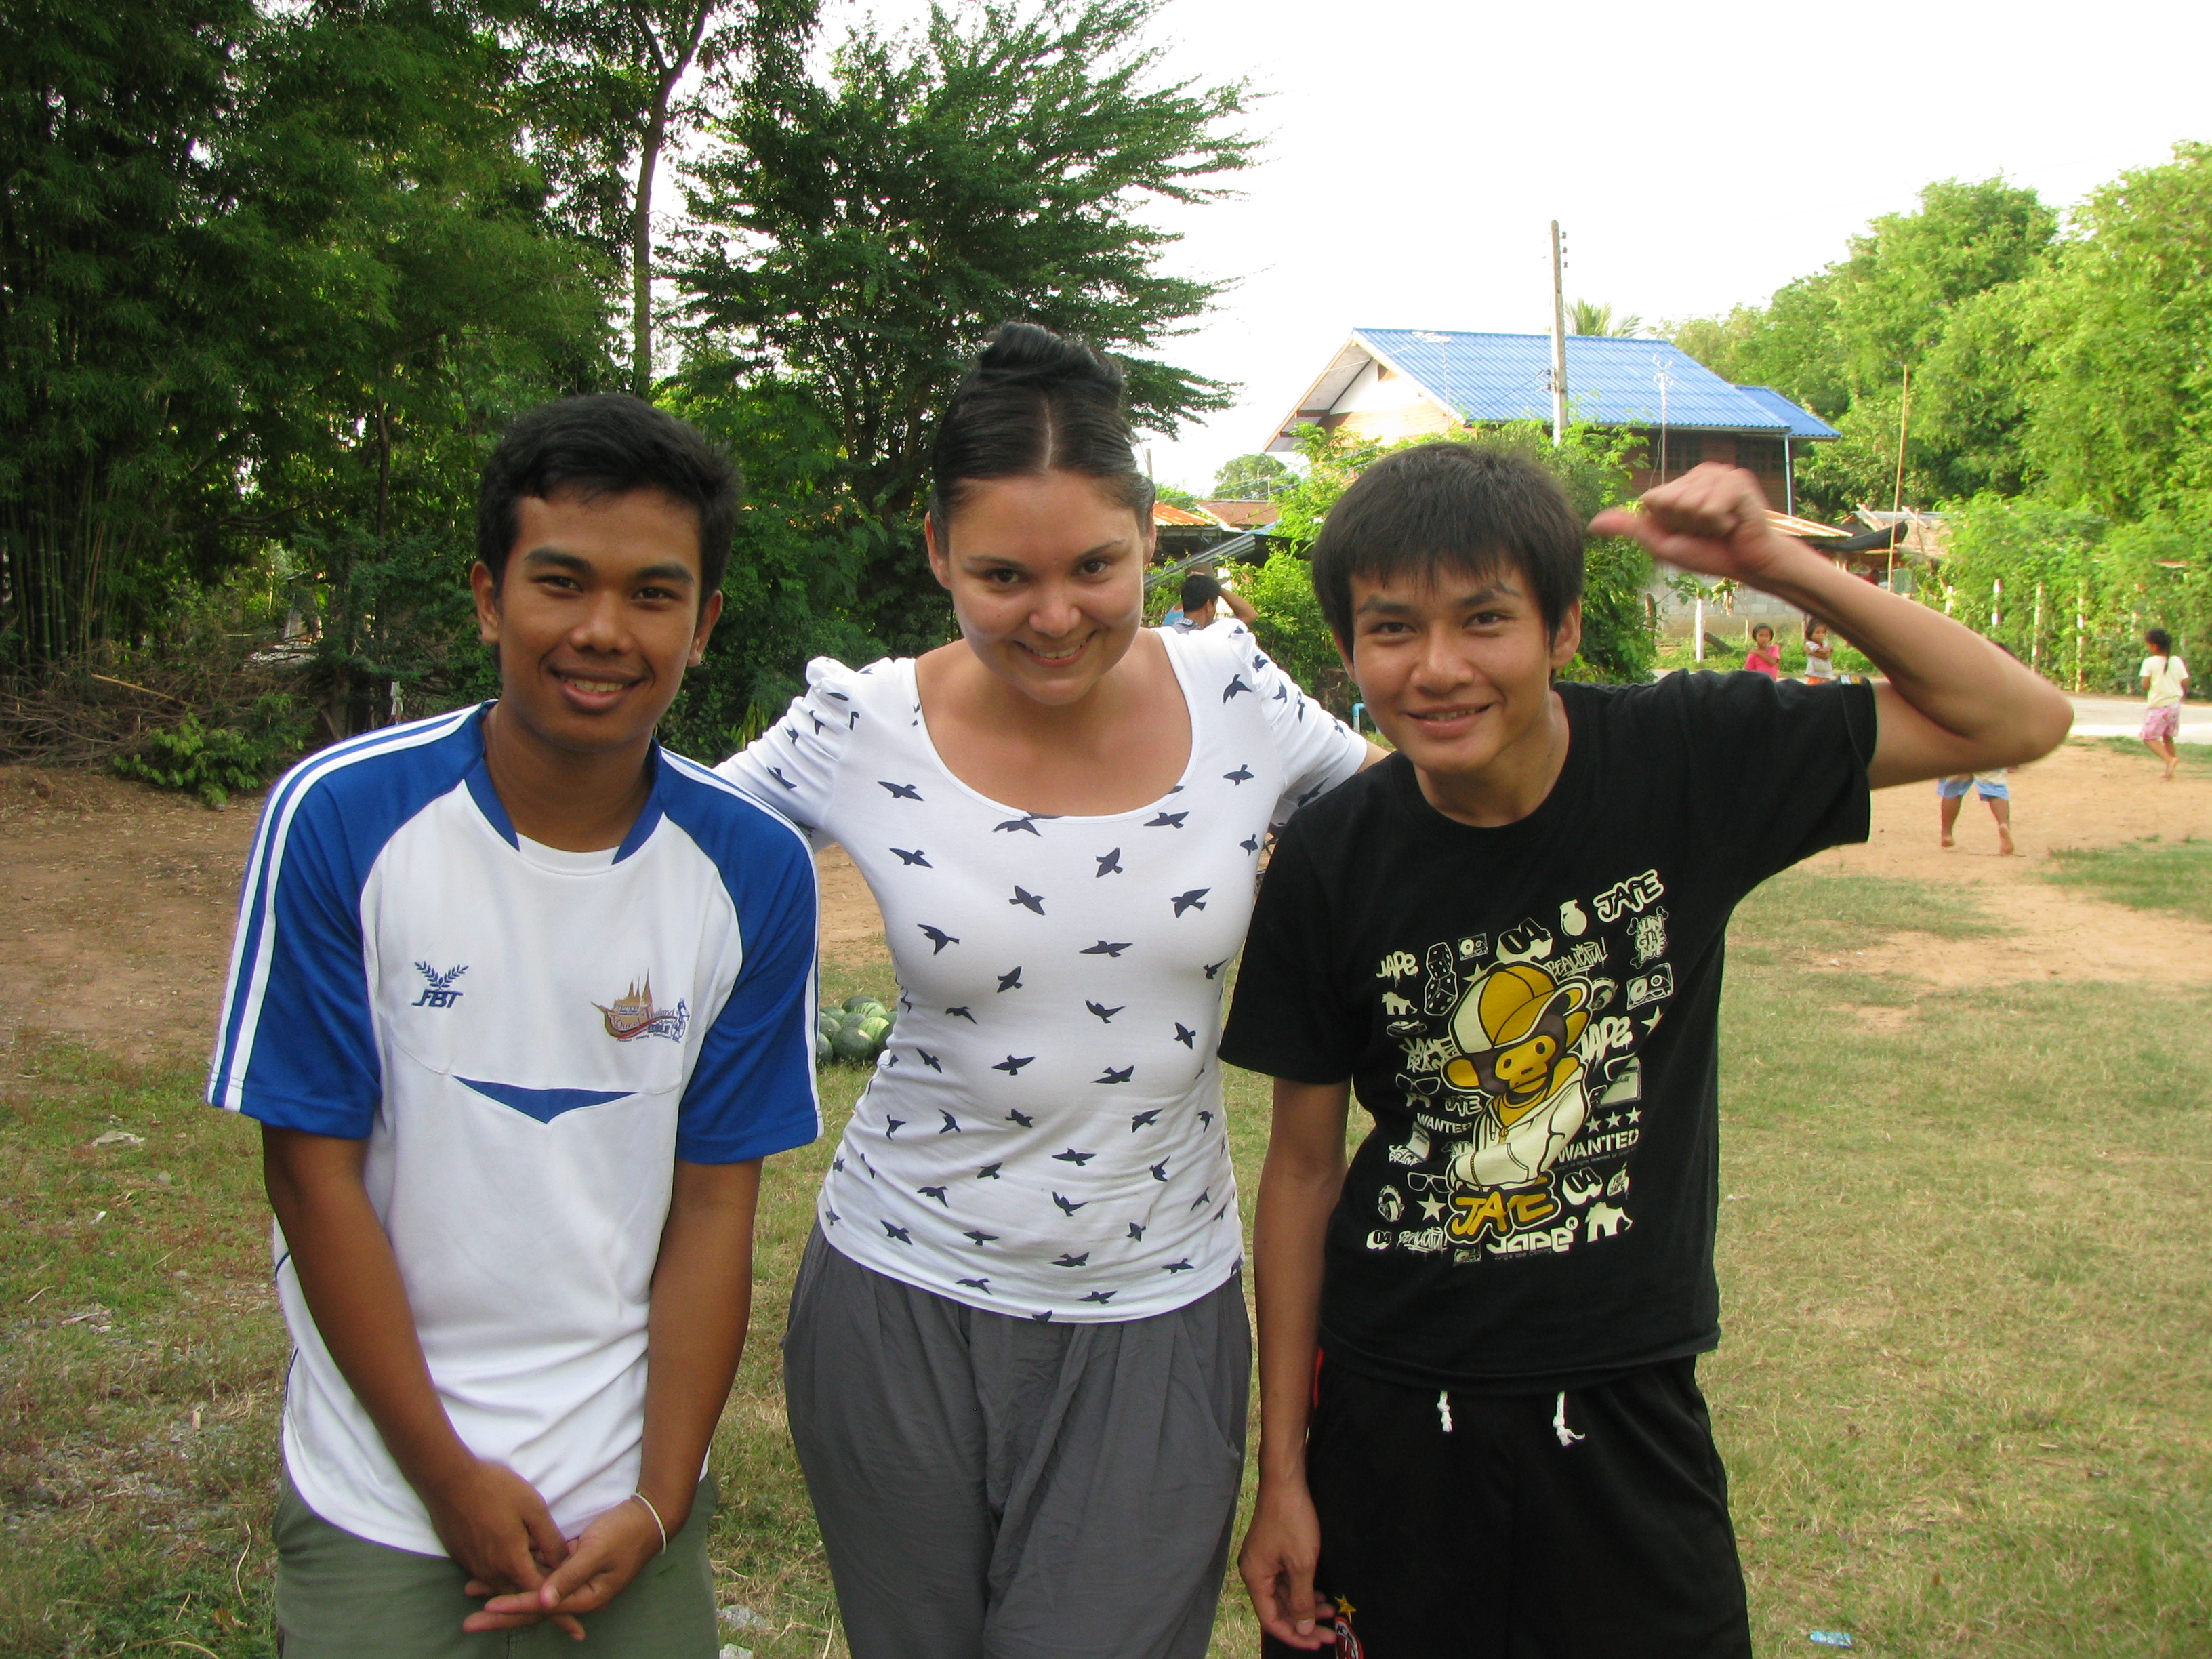
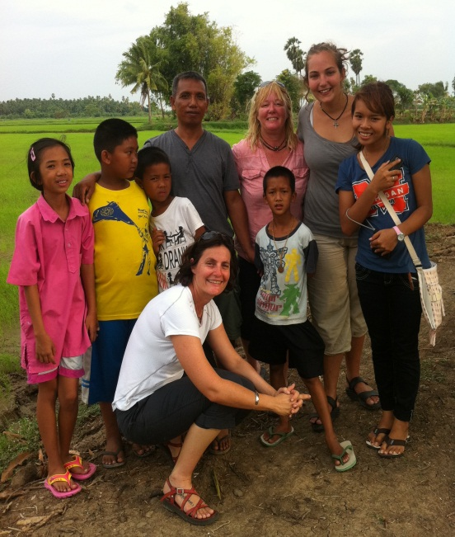
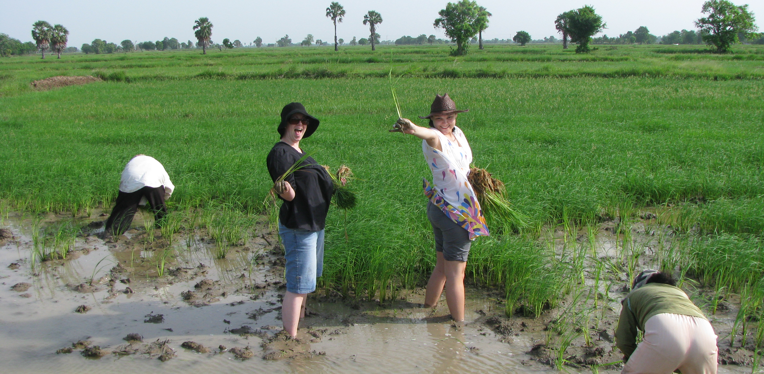
Australian Social Work Students in Thailand - 2011

Slide 7
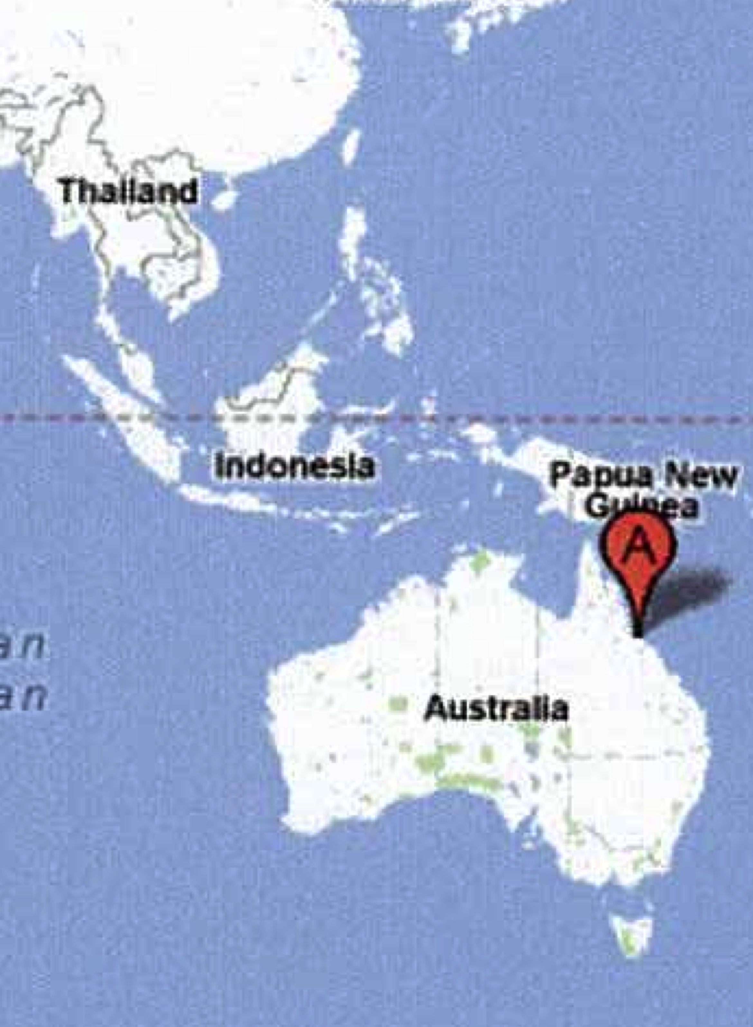
What has the Project Involved continued…
2012
  Thai students travelled to Australia
  Recruiting the second group of Australian students
  Australian students travelled to Thailand
  Research undertaken to gain feedback on the Australian students’ experience

Slide 8
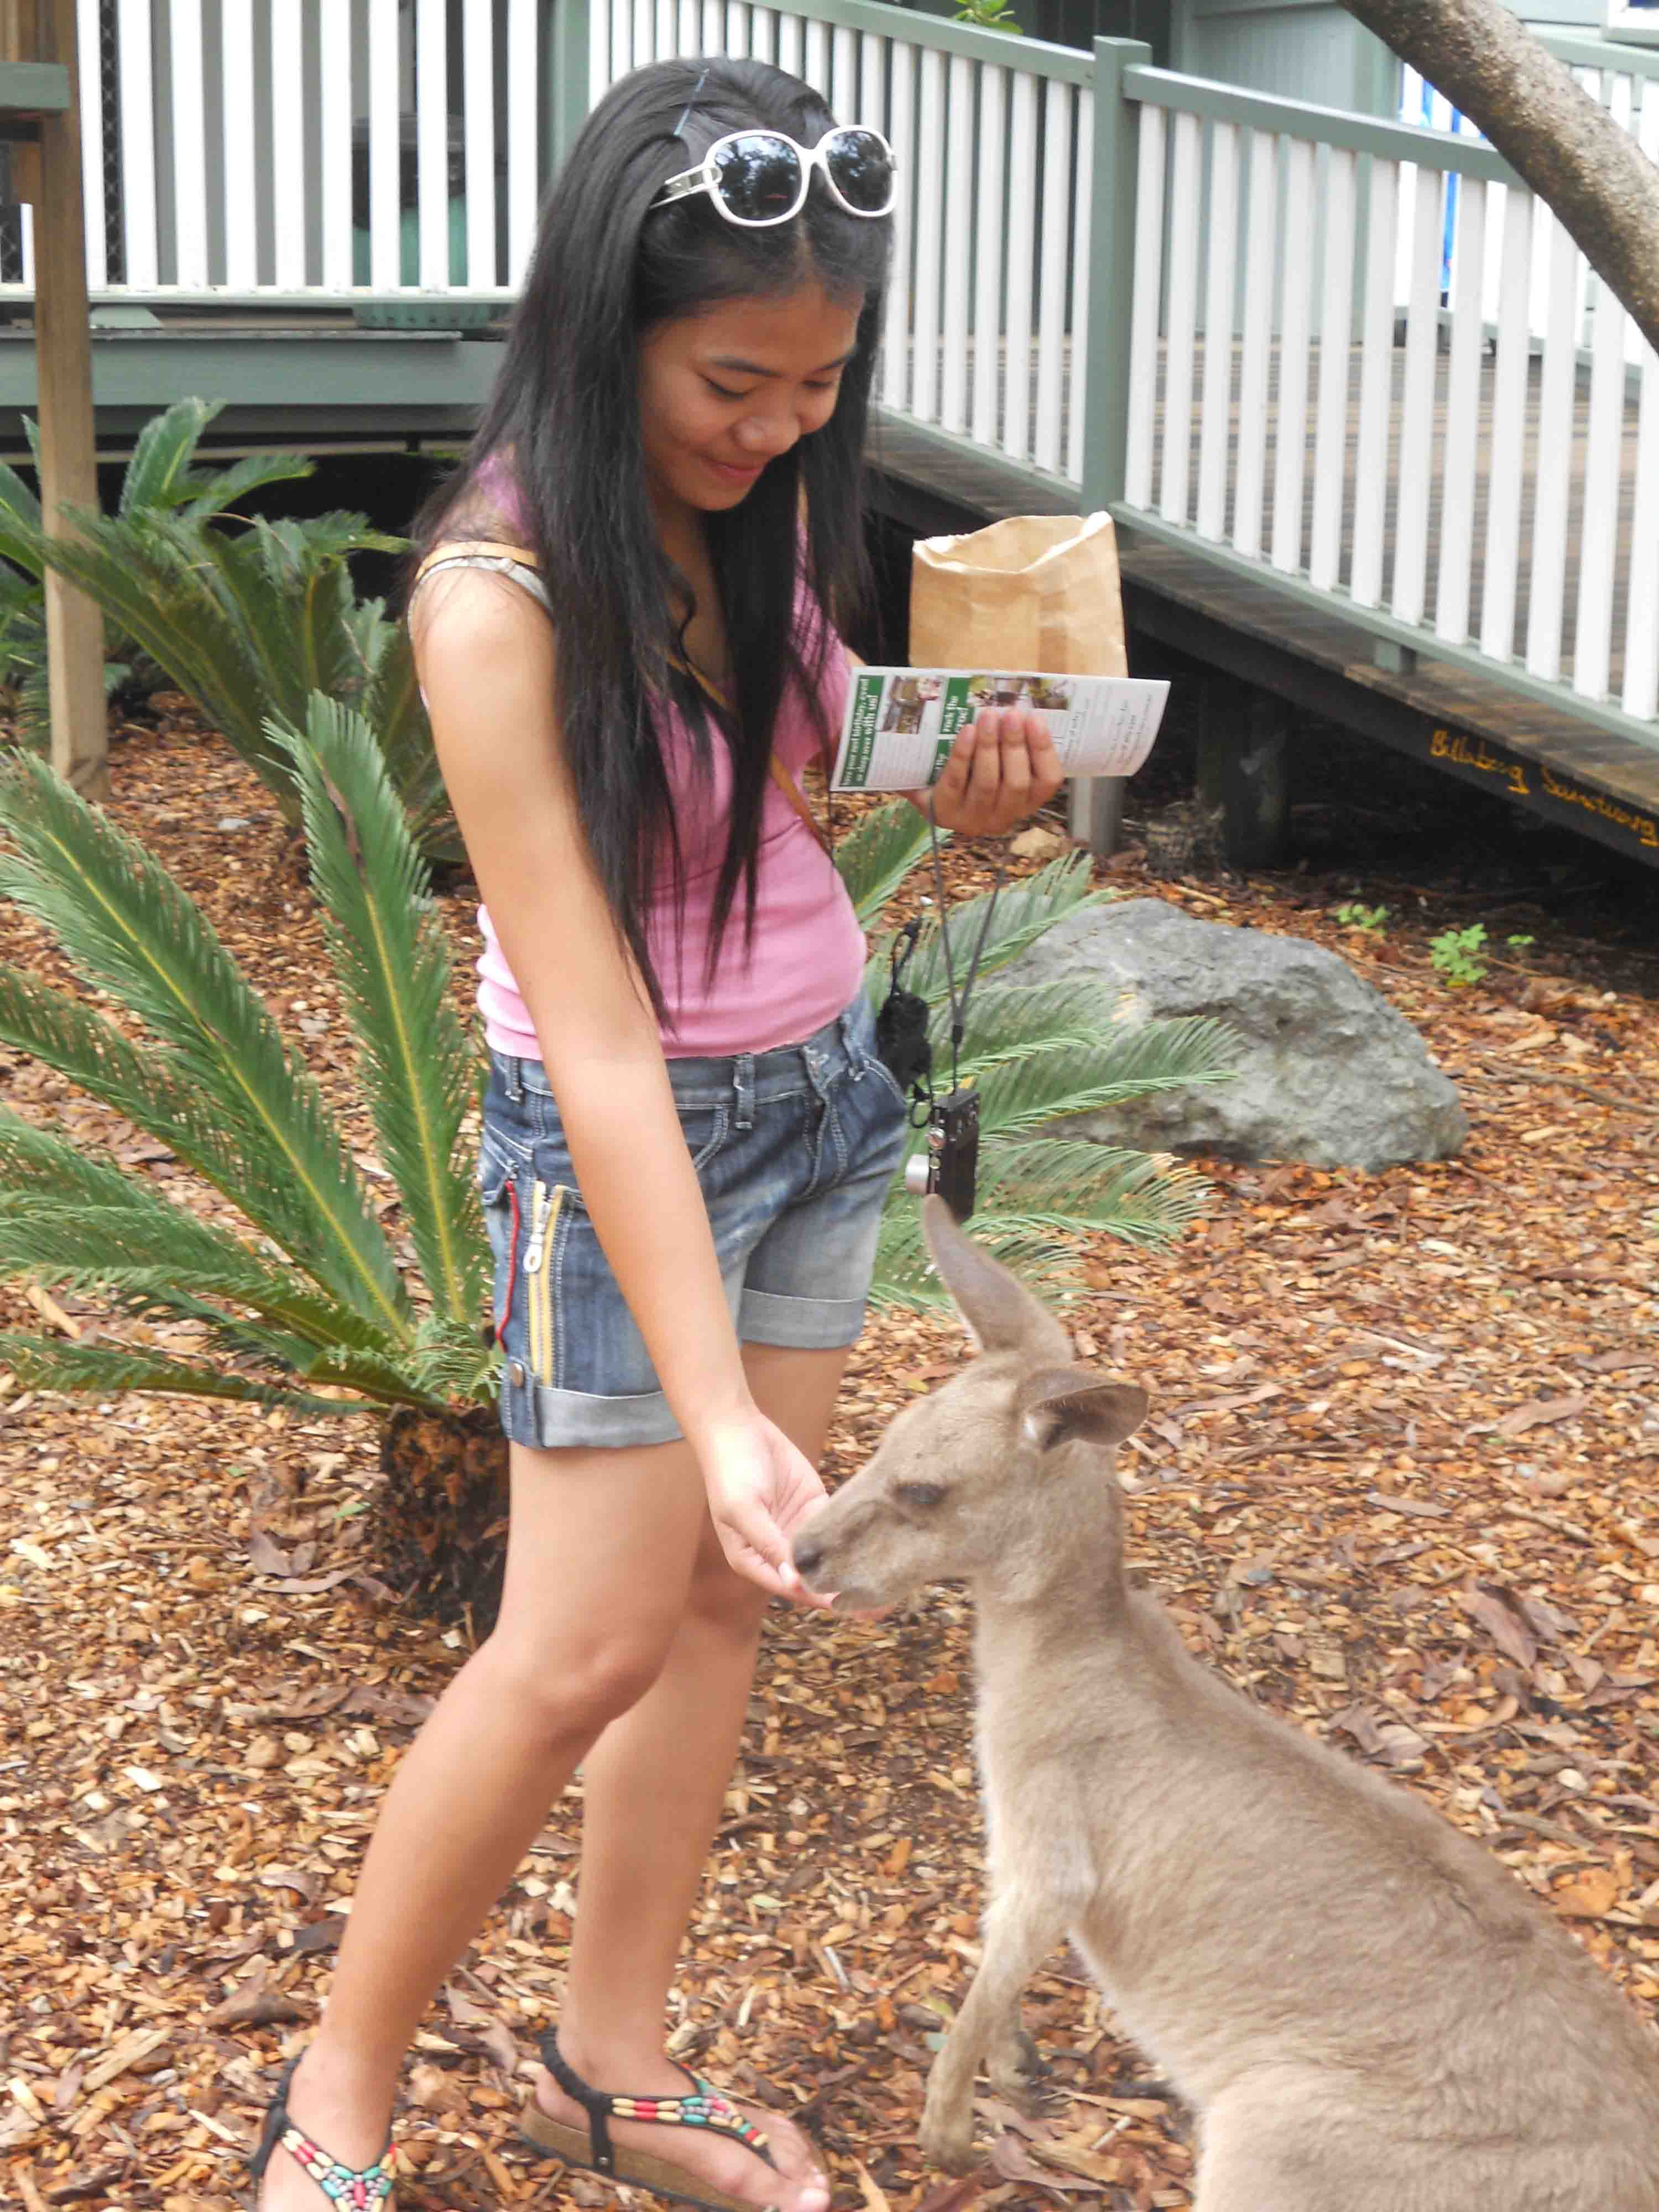
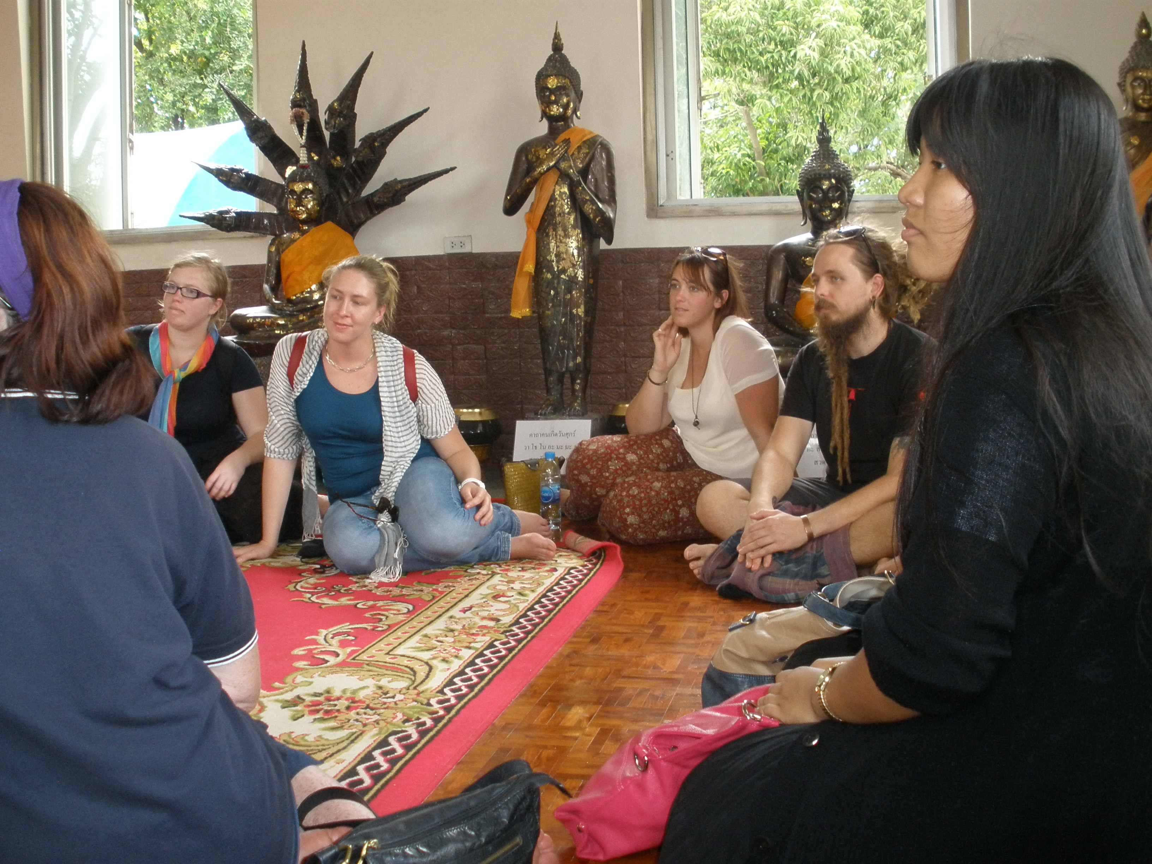
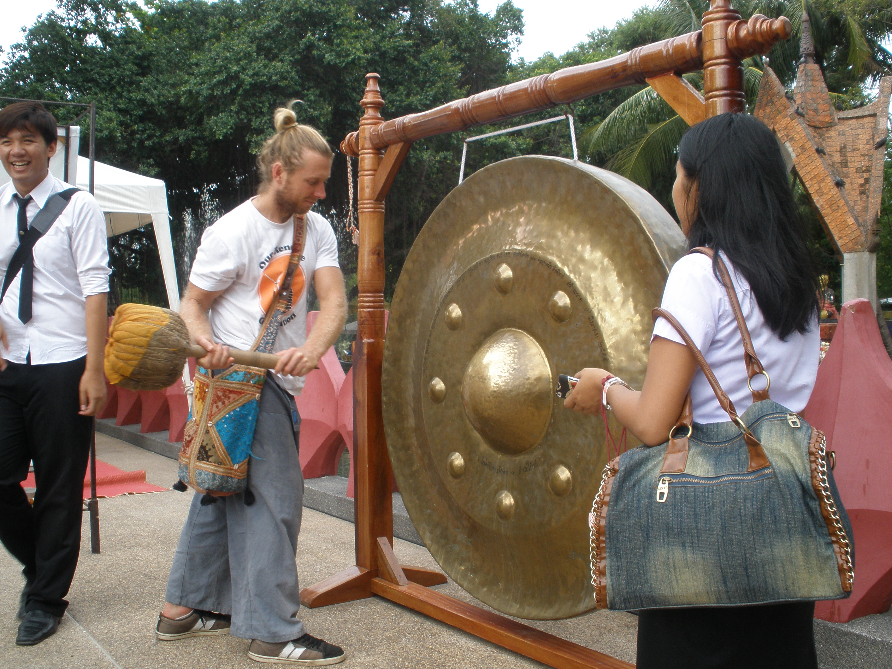
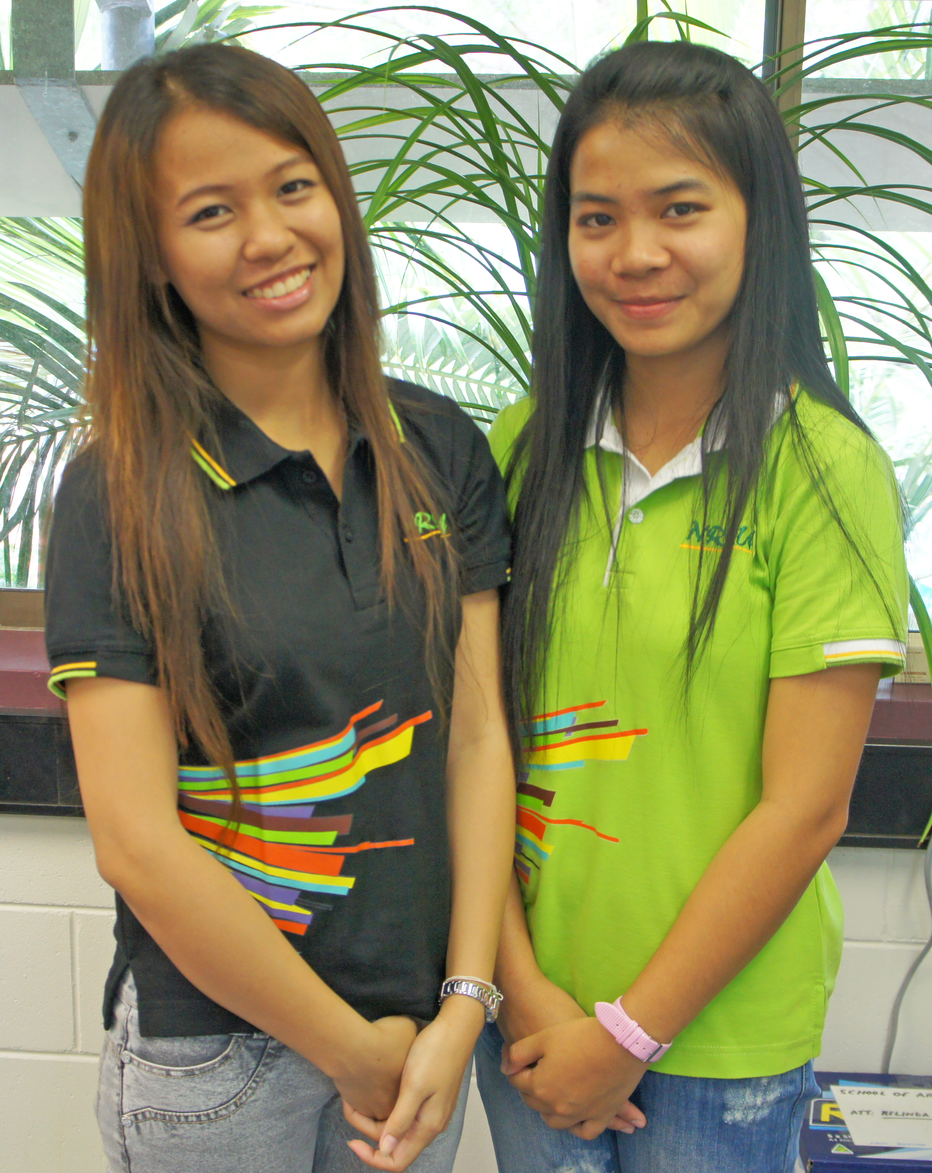
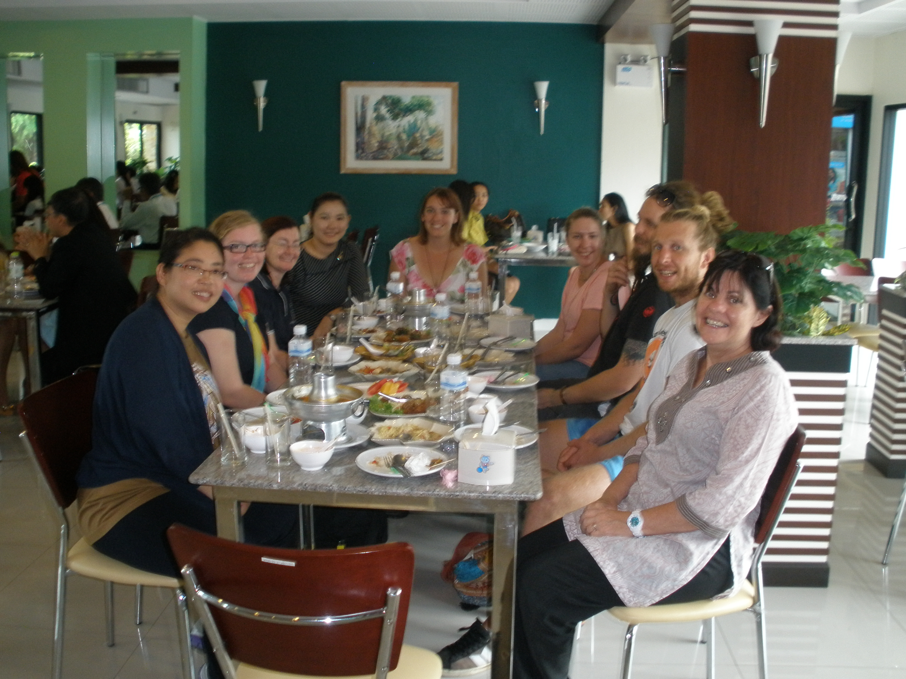
Thai and Australian students - 2012

Slide 9
Evaluating the Program
Research Aim
To assess, from the perspective of Australian* Social Work and Human Services students, the experience of participating in community development programs in Thailand as part of the practice-based education program.
Specifically, the research focused on students’ reflections on their cross-cultural experiences and their development of cultural competencies.
*Thai students will be interviewed in 2013
Methodology
  Qualitative
  In-depth interviews
  Six students interviewed from the 2011 and 2012 cohorts
  Grounded theory - thematic analysis
  Ethical clearance obtained

Slide 10
Findings: Initial Reflections
Students saw the program as a positive learning experience.
They had carefully considered what they hoped to achieve and what personal and professional qualities they would bring to the the project.
Students saw an opportunity to enhance their academic learning and put their learning into practice.
Students’ learning goals were not only related to the community based experience in Thailand, but were also related to career aspirations, connecting with fellow students and personal development.
The learning that occurred, as identified by the students, tended to be broad and general rather than specifically focused on sets of skills or areas of social work practice.

Slide 11
For example students’ commented:
“A world of difference studying something from a book and actually getting out and doing it…”
“Because I am an external student I thought it would be good to have contact with other students”.
“My interest was to work in international development and aid work” – “To get a taste of what (community development work) would be like”
“Because we look at theories like anti-oppressive practice and cultural sensitivity – it’s fine to have an academic understanding – so to experience the culture through a lens of theoretical understanding was very helpful for me. I didn’t anticipate it, but that is what I got”

Slide 12
Findings: Impact of Students’ Life Experience and Other Characteristics
The students that participated in the PBE program were diverse. They were at different levels in their degree, and some were school leavers and others had many years of work experience. Many had previous and extensive travel experience, including to Thailand, whilst others had never left Australia before. Accordingly their expectations of the program and what they learned from their experience varied.
“Because I have travelled a fair amount I thought I would display leadership and resilience”.
“At the time I had only just enrolled in social work and I’m keen to try anything new and have a new experience and I love travel”.
One student worked as a school welfare officer in Australia and found the knowledge to be transferable to her Thai community experience – “without the cultural barriers”

Slide 13
Findings: The Design of the Program
Whilst acknowledging the diversity of student experience and expectation, students anticipated that the program would provide structured learning goals and outcomes, as well as pre-briefing sessions that focused on social work values, learning in groups and practice in cross-cultural contexts. Students also reflected on the experience of working in groups and working in a variety of Thai organisational and community contexts.
“A group discussion before the experience – about values, case studies – what we hope to achieve – to provide a framework and a point of reference”.
“I don’t know how it is possible to have greater group cohesion – maybe only for students between third and fourth year, so people have the skills to deal with group things and conflicts that may arise”
“Because it was such a varied experience I suppose we weren’t able to get into any depth…perhaps that’s because I’ve done a lot of travelling”.

Slide 14
Findings: Cross-cultural Experiences and the Development of Cultural Competencies
Students reported a variety of learning experiences with many opportunities for cross cultural learning and reflection and the development of cultural competencies.
“I learnt about environmental practices and sustainability and the community orientation that contrasted with and highlighted Australian individualism”.
“Opened my mind to to different possibilities – the contrast between the managerial Australian approach and the Thai practical, community-based approach… the contrast provides a better understanding of the Australian social service context”
“The things that youth experience in our society are really similar to the experiences of Thai youth - so wanting to have the latest things like iPhones – the stresses on parents about the influences of popular culture…Regardless of where you are in the world – everyone shares certain things…”
This made me appreciate being patient and made me realise that the first thing you have to do is really feel with people, and share with people and open up your heart to people – I know those things in theory but I didn’t realise the real process of doing those things until I was there…”

Slide 15
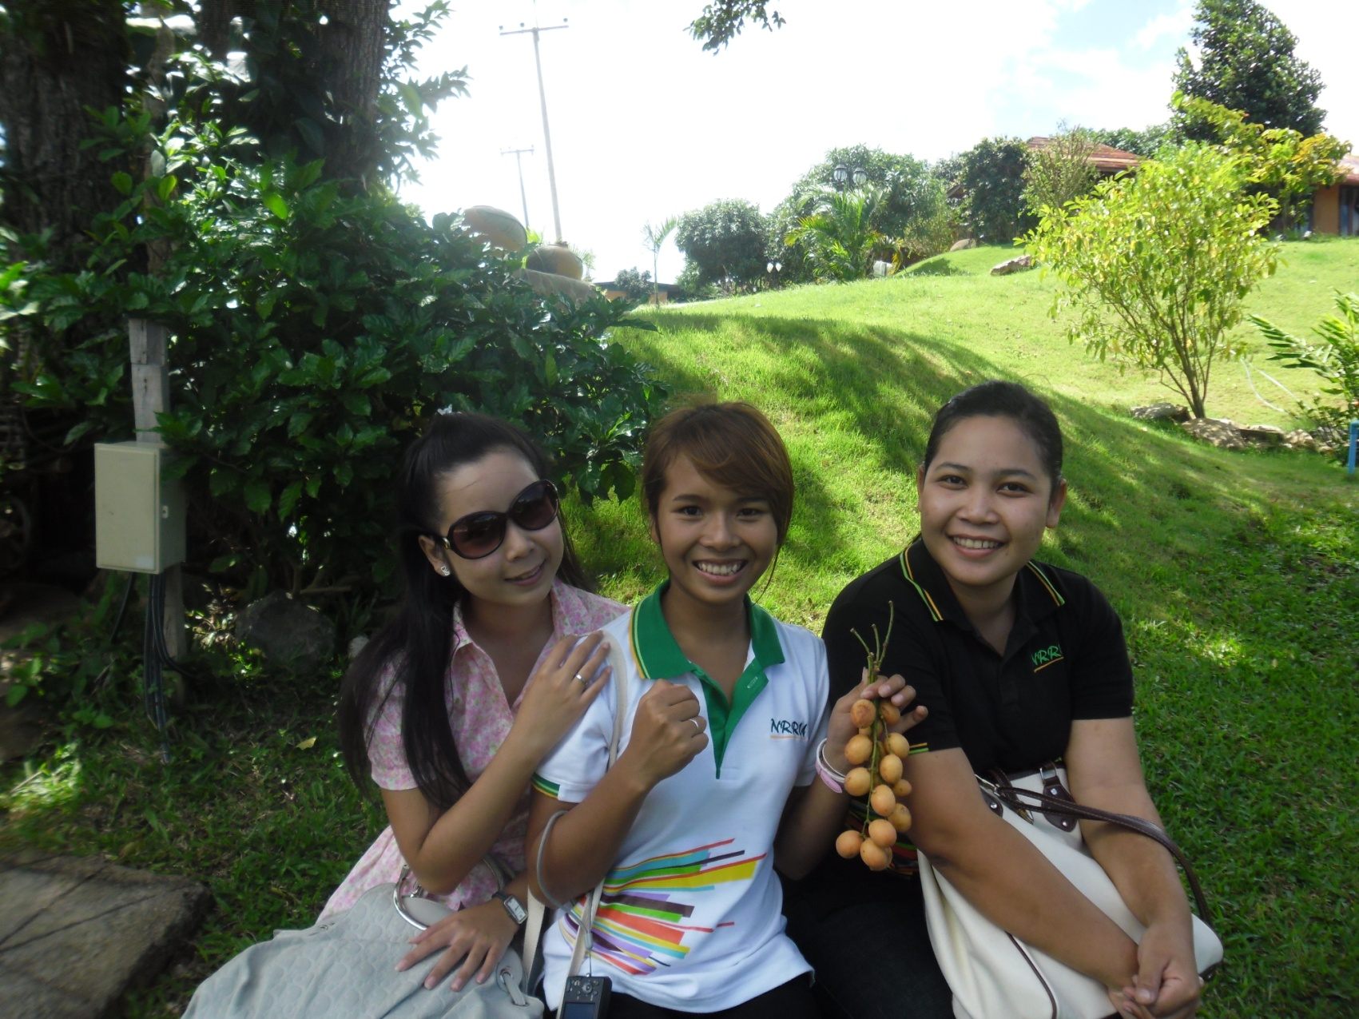
Overall Reflections
A worthwhile endeavor the enhances student learning by reinforcing the connection between academic learning and practice across cultural contexts.
Recognise the diversity of the individual students who are participating in the program and design a program that is sensitive to the individual needs of students.
Provide opportunities for students to prepare and de-brief as a group.

Slide 16
Design a program with clear learning goals, outcomes and expectations that facilitates:
understanding and implementation of ethical social work practices.
exposure to international and cultural experiences that develop and/or widen student experience and broaden their knowledge base.
understanding of how personalities, values and experiences influence perceptions of self and others.
the application of knowledge and skills acquired in the course to the realities of social work practice.

Slide 17
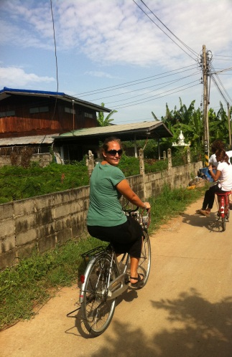
Conclusions
This project demonstrates that drawing on the diverse expertise, experience and contacts of a cross-disciplinary academic team can deliver innovative, internationally based, work integrated learning experiences for the benefit of students and their communities.
We also intend that this project provides the framework for the sustainable development of international practice-based education experiences for social work and human service students.

