Slide 1

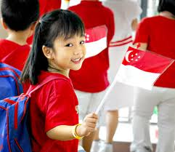
Pre-education in Singapore
Are there ethnic differences in parental attitudes?
Research Team: Dr Amie Frewen, Dr Margaret Carter, Ms Natasha Riard and Ms Eileen Chew
Funded by: JCU - Singapore
Notes:
This is an alternative title page with space for images.

Slide 2
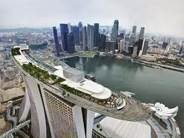
Outline
Background
Singapore
Method
Results
Implications for the wider community
Notes:
Slide for body text

Slide 3
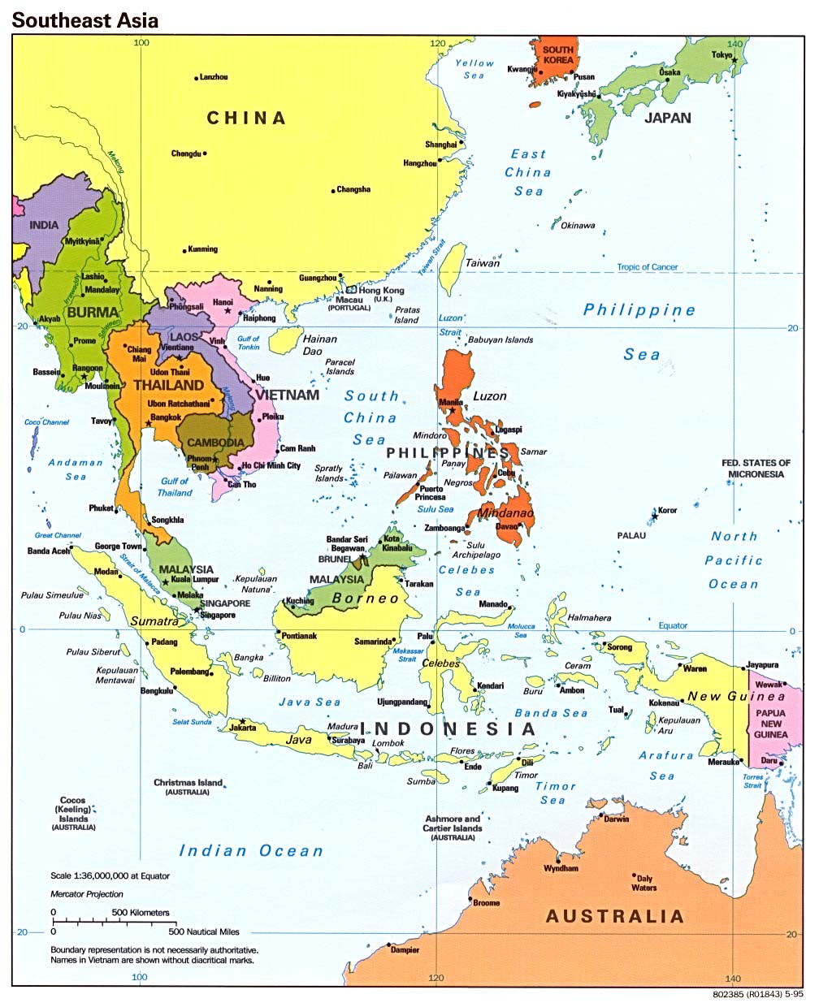
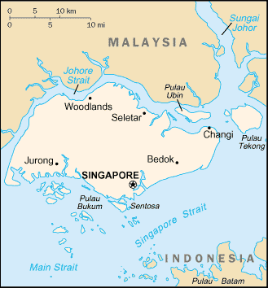
Singapore
1800’s: British rule
WW2: Invaded by Japan
1963: Independence from
British rule Malaysia
1965: Republic of Singapore
Thriving Economic Hub and Education Hub
Population 5.18 million people
74% Chinese,13.4% Malay, and 9% Indian, 3.2% Eurasians
Notes:
Singapore is a world leader in several economic areas: The country is the world's fourth-leading financial centre,^{[79]} the world's second-biggest casino gambling market,^{[80]} one of the world's top three oil refining centres, the world's largest oil-rig producer, and a major ship-repairer.^{[81][82][83]} The port is one of the five busiest ports in the world.^{[80]} The World Bank has praised Singapore as the easiest place in the world to do business^{[80]} and ranks Singapore the world's top logistics hub.^{[84]} The country is also the world's fourth-largest foreign-exchange trading centre after London, New York and Tokyo.^{[85]}

Slide 4
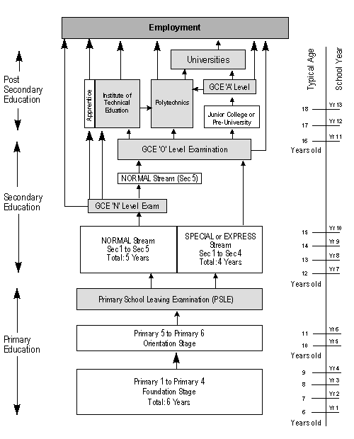
Education System
Hours:
Govt:
8:00 – 12:00 or
1:00 – 5:00
Private:
Varies (3-4hrs)
Notes:
This is an alternative title page with space for images.

Slide 5
Focus on education
By the time registration started on Monday at 7.30am, more than 70 eager parents were filing past the school gates to pay a S$100 non-refundable administration fee.
Her son is a straight A student in a top boys school here yet this mother spends $5,800 a month on his tuition
OUTRAGE over kindergarten's tuition classes (2 hour classes on sat for Maths & English)
70 new school-based student care centre’s to be built to provide support when they are discharged from school
Singaporeans will be given priority over PR in the Primary 1 ballot process

Slide 6

Background
PISA Study – 2009
  4th on Science literacy
  5th in Reading literacy
  (behind Shanghai, Korea, Finland and Hong Kong)
  2nd on Maths literacy
  (behind Shanghai)
  Why so good?
  Is this just a ‘chinese’ thing? ‘Kiasu’ culture / Singapore ‘thing’?
  Tiger Mums? When does it start?
Notes:
Programme for International Student Assessment (PISA) is an international comparative survey of
15-year-olds’ knowledge and skills in reading, mathematical and scientific literacy. PISA seeks to measure how
well young adults have acquired the knowledge and skills that are required to function as successful members
of society. PISA is a regular, ongoing series of assessments that are administered in participating countries every
three years. PISA provides a set of indicators that can be tracked across time to assist in monitoring trends in
these educational outcomes.
Data were collected for the fourth cycle of PISA assessments in 2009. Sixty-four countries or economies originally
participated in PISA 2009: all 34 OECD countries and 31 partner countries and economies.
Kiasu is commonly compared to Kiasi (literally, fear of death) and both are commonly used to describe behaviour where Kiasu or Kiasu-ism means to take extreme means to achieve success and Kiasi or Kiasi-ism means to take extreme means to avoid risk.

Slide 7
Method
Online Survey of parents with a kindergarten aged child – (English) n= 244
  Demographics
  Child Rearing Beliefs Scale (Okagaki & Sternberg, 1993)
    4 scales developing 1. Problem solving 2. Creative Skills 3.Conforming behavior and 4. Practical skills
  Parental Involvement Scale (Reynolds, 1992)
    Reading / Cooking / Play / Discussing with schools / teachers etc
  Diary of child’s typical weekday and weekend
Notes:
Child rearing beliefs: What parents should do with their kindergarten children ie help children set goals, teach kids to organise and plan their time, show them new things, play pretend games, how to look after siblings, take care of belongings, do chores etc
Parental Involvement Read to your child, cock, attend meeting at school, discuss progress with child

Slide 8
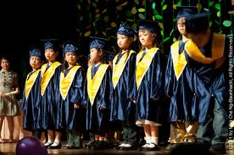
Children
  Who are they?
  16 % only child*
  49% two children
  22% three children
  51 % Female & 49% Male
  2% identified as having a special need
  * Singapore does not have a one child policy
Notes:
This is an alternative title page with space for images.

Slide 9
Household
Income | Low (4,420) 42% Mid (4,421 – 10,100) 52% High (10,000k + above) 6%
Languages (including dialects eg Cantonese, Hokkien, Teochew, Tagalog) | 34% English, 27% English + others, 39% not english
Number of languages | 1 language = 3.3% 2 languages = 75% 3 languages or more = 22%
Religion | Similar:73% Different: 25% Single parent: 2%
Marital Status | 95.9 Married
Family status | Nuclear 43% Nuclear + extended family = 31% Family plus live in maid = 25% Single parent = 1%
Notes:
This is an alternative title page with space for images.

Slide 10
Sample
 | Mother (n= 180) | Father (n=64)
Age | X= 37 years Range=25-67 SD=6.0 | X=40 years Range=26-65 SD=6.2
Ethnicity Chinese Malay Indian Other | 53% 24% 13% 9% | 55% 20% 15% 11%
Education No formal Education Primary Education Secondary Education GCE / A level Diploma Bachelor Post graduate | 2% 5% =34% 27% 9% 28% 22% 7% | 1% 11% 2% 9% 26% 22% = 57 % 9%
Occupation Housewife / husband Professional Associate professional and t technician Senior Officers /Manager | 42% 15% 12% 11% | 2% 25% 27% 12%
Number of hours worked per week | 34 hrs | 43 hrs

Slide 11
Parental Beliefs
Beliefs | Chinese | Others
Problem Solving (Max = 30) | X = 22 | X = 24**
Creative (Max = 24) | X = 19 | X=20***
Conforming (Max = 24) | X= 18 | X= 19*
Practical (Max = 48) | X= 32 | X= 32
*p=0.05 ** p=0.01 ***p=0.0001
Notes:
This is an alternative title page with space for images.

Slide 12
Parental Involvement (a)
 | Chinese | Others
Home Involvement (Max = 16) (Cooking, Reading, Outings & Discussing progress) | x = 11.3 | X =12.5***
School Involvement (Max = 20) (Communication with school, participate in school activities, talk with teachers and attend meetings) | X = 9.1 | X =9.8*
***p=0.0001, *p=0.05
Notes:
This is an alternative title page with space for images.

Slide 13
Parental Involvement (b)
Notes:
This is an alternative title page with space for images.

Slide 14
How important is academics?
Overview
Acad
130 (53%)
Chinese
59 (45%)
Others
71 (55%)
Others
39 (16%)
Chinese
42 (56%)
Equally
75 (31%)
Chinese
23 (59%)
Others
16 (41%)
Others
33 (44%)
Notes:
This is an alternative title page with space for images.

Slide 15
Tuition
Tuition
No
203
(83%)
Yes
41
(17%)
Chinese*
27
(66%)
Others
14
(34%)
Weekday
2 hours
Weekend
1 hour
Weekday
2 hours
Weekend
0 hour
* p=0.05
Notes:
This is an alternative title page with space for images.

Slide 16
Enrichment classes
Enrich
Yes
125 (51%)
No
119 (49%)
Chinese 71 (57%)
Others 54 (43%)
Academic 65 (92%)
Sports* 18 (23%)
Arts 32 (45%)
Social Emotional 2 (4%)
Academic
47 (87%)
Sports 5 (9%)
Arts 18 (33%)
Social Emotional 4 (7%)
*p=0.05
Notes:
This is an alternative title page with space for images.

Slide 17
What are kids doing?
 | Chinese (Median) HOURS / WEEK | Others (Median) HOURS / WEEK
Active Play – Week Days | 6 | 8
Weekends | 4.5 | 6
Passive Play – Week Days | 7 | 7
Weekends | 6 | 6
Social Play - Weekdays | 9.5 | 9
Weekends | 6 | 7
Electronic / educational | 1 | 2
Weekends | 1 | 2
Notes:
This is an alternative title page with space for images.

Slide 18
Sleep
  Average 9 hours
 | Chinese | Others
Go to sleep | 10pm – 11pm | 10pm-11pm
Wake up | 7:30am – 8am | 7am - 9 am
Notes:
This is an alternative title page with space for images.

Slide 19
Primary School enrolment
 | Move House | Volunteer | Enrol (Sibling)
TOTAL
Yes | 91 (37%) | 96 (39%) | 220 (90%)
No | 153 (63%) | 148 (61%) | 24 (9.8%)
Chinese
Yes | 37 (41%) | 42(44%) | 113 (51%)
No | 87 (57%) | 82 (55%) | 11 (46%)
Others
Yes | 54 (59%)* | 54 (56%) | 13 (49%)
No | 66 (43%) | 66 (45%) | 12 (54%)
*p=0.05
Notes:
Move house to the catchment area

Slide 20
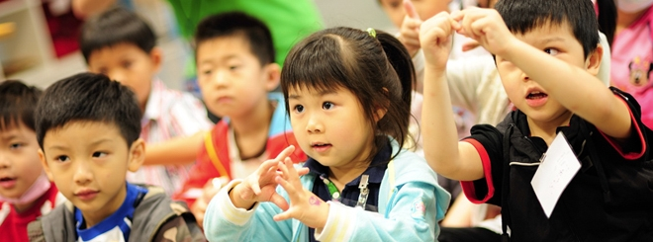
Conclusions
42% are living off less than $4420 SGD / month ($3498 US / $42k / year)
High rates of bilingualism but also 40% don’t speak English at home
¼ mothers only have a high school education or less
¼ have a live in maid
Parents working long hours, only time to see children is the evening
17% of children are already in tuition classes and 51% in enrichment classes
53% believe Academic success is more important than other areas of their child’s development
Not just a “Chinese thing”
Notes:
This is an alternative title page with space for images.

Slide 21

Implications
Societal pressure to succeed academically –
starting from an early age
Low income families not wanting to
disadvantage their children by not enrolling
in extra classes
Low literacy rates, long working hours –homework? And when?
Longer term implications? Are there longer term mental health effects?
Policy implications? How do you achieve a balance in the cultural norms?
Notes:
This is an alternative title page with space for images.

Slide 22
Where to from here?
Further analysis
Publication of results (cultural factors, effects of parental factors on time spent with their children)
Further studies:
  Better understanding of differences across asian countries (not just asian vs western)
  Better understanding of any effects on mental health / self esteem?
Further information: Dr Amie Frewen
: amie.frewen@jcu.edu.au
Notes:
This is an alternative title page with space for images.

