Slide 1
2011 Australasian Tax Teachers Conference
Trials and tribulations in Teaching Tax Law.
Tax - it’s much more than numbers!

Slide 2
Some things learnt from past conferences
Trials and tribulations in teaching tax law
Michael Blissiden, “Using the Web as a Resource to Facilitate Student Learning and Engagement on Landmark Taxation Law cases”, Tasmania 2008
Colleen Mortimer, “Tax Lecturer Replaced by a Computer: Using technology in your teaching – dispelling some of the myths”, Tasmania 2008
Bernadette Smith and Sonia Shimeld, “Drawing accounting students into tax”, Wellington 2005
Helen Hodgson, “E-quizzes – a case study”, Wellington 2005
Margaret McKerchar, “An appraisal of research-led teaching in the context of taxation: can both teacher and student benefit”, Adelaide 2004
Tom Delany, “Tax teaching – 2004 style”, Adelaide 2004
Brett Freudenberg and Lisa Samarkovksi, “Enthusing students to learn through contextualization and information literacy”, Sydney 2010

Slide 3
My approach to teaching tax
Trials and tribulations in teaching tax law
Dealing with the detail
Dealing with the complexity
Dealing with the numbers
Dealing with the philosophical and ethical dimension
Keeping their eyes open
Keeping it real

Slide 4
Section 165-55 of the GST Act 1999
Trials and tribulations in teaching tax law
“For the purposes of making a declaration under this Subdivision, the Commissioner may:
  treat a particular event that actually happened as not having happened; and
  treat a particular event that did not actually happen as having happened….”

Slide 5
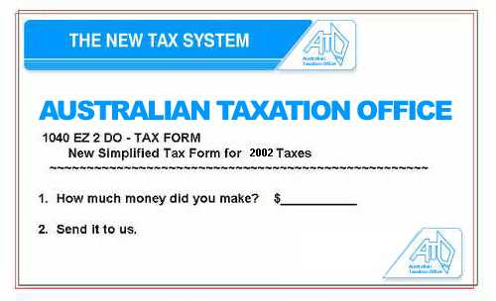
Trials and tribulations in teaching tax law

Slide 6
Some constraints on how we teach
Trials and tribulations in teaching tax law
Time constraints
Institutional constraints
Surface v deep learning
Policy v black letter law
Foreign students
Business v Law students
Marshalling technology
Assessment

Slide 7
Trials and tribulations in teaching tax law
Over to you…..

Slide 8
Trials and tribulations in teaching tax law

